Slide 1
EBRD Strategy for Bosnia and Herzegovina 2014-2017
DONOR COORDINATION FORUM
6 February 2014

Slide 2
EBRD and its Objectives
European Bank for Reconstruction and Development:
International financial institution, promotes transition to market economies in 34 countries from central Europe to central Asia to southern and eastern Mediterranean
Owned by 64 countries and two inter-governmental institutions
Objectives:
To promote transition to market economies by investing mainly in the private sector
To mobilise significant foreign direct investment
To support privatisation, restructuring and better municipal services to improve people’s lives
To encourage environmentally sound and sustainable development

Slide 3
EBRD and its Instruments
Loans
Equity
Syndication
Senior, subordinated, convertible
Long term
Working capital
Fixed / floating interest rates
Political risk guarantees
Common/preferred shares
Mezzanine financing
Exclusively minority participations (up to 35%)
“Portage Equity“
In-house syndication unit
Lender of record
EBRD‘s Preferred creditor status attracts other financiers

Slide 4
EBRD is a major investor in BiH
  EBRD engagement in BiH since August 1996:
  EBRD signed 115 projects with cumulative business volume of EUR 1.6 billion.
Mobilised co-financing of EUR 2.1 billion.
EBRD activity during the previous strategy period 2010-2013:
  EBRD signed 46 projects for total EUR 466.3 million.
  Mobilised co-financing of EUR 1 billion.
  Undrawn ratio improved from 53.1% in December 2010 to 39.9% in December 2013.
In 2013:
  EBRD signed record 18 new projects amounting to EUR 208.2 million.
  Excellent progress in implementation of large infrastructure projects, with disbursements reaching EUR 201.4 million.
Notes:
Number of projects doesn’t match

Slide 5
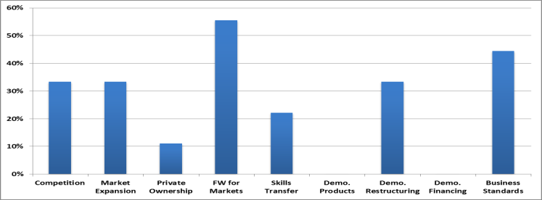
EBRD Objectives in BiH 2010-2013
Strategic priorities in 2010 - 2013:
Provide support in constructing new and upgrading existing infrastructure, address reforms in the municipal and environmental infrastructure sector and provide financial support for energy efficiency projects;
Provide financing to MSMEs and support the further development of the banking sector;
Support strategic investors in ongoing privatisation or restructuring, in particular in agribusiness, industrial, property and tourism, wood and metals processing sectors;
Pursue policy dialogue at all institutional levels and assistance in key reforms required for EU approximation.

Slide 6
Bosnia and Herzegovina:
EBRD portfolio by sector

Slide 7
Selected infrastructure projects in BiH
Signed | Client | Project
2008 2013 | Corridor Vc | 2008: Loan of EUR 180 m for construction of priority motorway sections of Trans-European Corridor Vc through Bosnia and Herzegovina. Parallel financing provided by EIB. 2013: Loan increase of EUR 25 million for two sub-sections of the motorway
2005 2010 | Regional Railways Project | 2005: EUR 70 m loan for railway track renewal and upgrade of station and route control signaling. Joint financing with EIB. 2010: EUR 10 m loan increase to top up savings and enable completion of the reconstruction of the southern section of railway Corridor Vc.
2007 2010 | Bijeljina Water and Wastewater Project Bijeljina II WWTP | 2007: EUR 7m loan to help finance construction of a waste water network and reconstruction of water supply network. 2010: Additional EUR 5m loan for the construction of a wastewater treatment plant and the expansion of the wastewater collection network. Grant co-financing of EUR 10.5m from EU and Sida.
2009 | Mahovljani Interchange | EUR 25 million loan to to finance the construction of the Mahovljani interchange, which is located on the Banja Luka to Gradiska motorway.
2011 | Sarajevo Urban Roads | EUR 16.5m for widening of two key urban road sections running through Sarajevo.
2011 | Brcko Bypass | EUR 28.5m for construction of bypass around the town of Brcko.
2012 | Banja Luka – Doboj motorway | EUR 150 million loan for the construction of a 37.8 kilometre long Prnjavor – Doboj motorway section, which is part of the total 76 kilometre motorway from Banja Luka to Doboj.

Slide 8

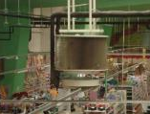

Case studies – Bingo
Type of project
Renewable Energy/ Energy Efficiency – Implementation of IEE measures in several BINGO outlets
Region
Bosnia and Herzegovina
Project goals
Increase energy savings Improve equipment reliability Reduce maintenance costs at existing outlets Reduce operating costs
Main investments
Lighting Refrigeration system Insulation panels Skylights Heat pumps- space cooling and heating
Investment size
Approximately € 5.4 million
Skylights at an already existing BINGO outlet
Fan coils
Air curtains
Expected operational results
Primary energy savings: 15,477 MWh CO₂ emission reduction: 4,700 t/year

Slide 9
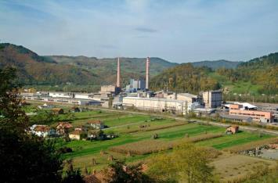
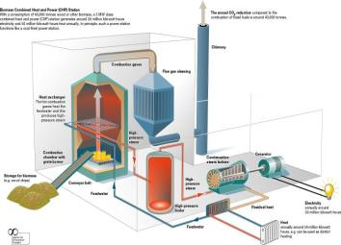
Case studies – Natron Hayat
Type of project
Renewable Energy – Construction of a new biomass CHP plant to replace an existing coal-fired power plant
Region
Bosnia and Herzegovina
Project goals
Utilize company’s biomass waste as fuel Reduce environmental impact of the wood waste Reduce operating costs related to energy (electricity and steam) Subject to availability of green feed-in-tariff the company can generate significant income from sale of electricity to the grid
Main investments
Biomass-fuelled boiler and steam turbine
Project size
€ 11 million
Expected operational results
Generate electricity and steam for its manufacturing process Sell surplus electricity to the grid CO₂ emission reduction: 275.000 t/year

Slide 10
WeBSEFF achievements in BiH
Western Balkans Sustainable Energy Credit Line Facility (WeBSEFF)
– a credit line facility of up to € 60 million for financing industrial energy efficiency and small renewable energy projects through Participating Banks in Western Balkans. Loans of up to € 2 million. 131 sub-projects financed throughout the region. Almost € 9.5 million of incentives have been paid out.
Bosnia and Herzegovina
55 projects; EUR 15 mln
Total CO₂ savings | 18,352 t/yr
Total energy savings | 46,278 MWh/yr
Slide 7

Slide 11
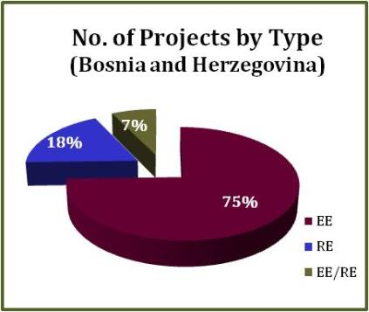
Project breakdown - Bosnia and Herzegovina
41 EE Projects
10 RE Projects
4 Combined (EE/RE) Projects
Total of 55 projects, of which
Raiffeisen Bank: 37
UniCredit Bank: 18

Slide 12
EBRD strategy for Bosnia and Herzegovina 2014-17
Strategy process based on a comprehensive involvement of the authorities and other relevant stakeholders (civil society, NGOs, various organizations/institutions):
    The authorities have received the draft strategy in July 2013.
    In accordance with the EBRD Public Information Policy (PIP), the draft Strategy for Bosnia and Herzegovina was posted on the EBRD web site in English and in the local language for 45 calendar days starting from 1 October 2013 to 14 November 2013. The start of the review process was also advertised through social media platforms (e.g. Facebook, Twitter, Google+, LinkedIn).
    In the course of the Strategy preparation, a delegation of the EBRD Board Directors met with representatives of CSOs on 18 March 2013 with the objective to gather civil society’s feedback on socio-economic, good governance and environmental challenges in the country.
    As part of the public consultation process, the EBRD Resident Office in Bosnia and Herzegovina hosted a workshop with civil society organisations on 6 November 2013 in Sarajevo with the aim to discuss and solicit comments on the draft Strategy. The event attracted 22 participants coming from 16 CSOs and one consulting company.

Slide 13
EBRD strategy for Bosnia and Herzegovina 2014-17
Strategy document includes:
    Overview of activities to date
    Political context
    Macroeconomic context
    Structural reform context
    Business environment
    Social context
    Legal context
    Energy efficiency and climate change context

Slide 14
EBRD strategy for Bosnia and Herzegovina 2014-17
Strategy document includes (continuation):
    Detail presentation of strategic orientations
    – key challenges and operational responses
    – policy dialogue priorities
    – environmental and social implications
    – access to capital
    – cooperation with other IFIs, EU and donors
    More detail analyses in the annexes

Slide 15
EBRD strategy for Bosnia and Herzegovina 2014-17
EBRD Board of Directors adopted the new 3-year strategy for Bosnia and Herzegovina in January 2014.
In the forthcoming strategy period the Bank will focus on:
    Restructuring and expansion of the local private sector.
    Forging closer linkages with wider regional markets.
    Promoting a more efficient and sustainable use of resources.
The Bank will seek to promote internal integration by actively seeking out investments that further deepen economic linkages between the two entities, and Brcko District, both with private companies and through institutional reforms in the public sector.
The EBRD will seek to align its operation with the priorities of local authorities and closely cooperate with other International Financial Institutions and donors, including the European Union

Slide 16
EBRD strategy for Bosnia and Herzegovina 2014-17
Strategic Orientations
• Restructuring and expansion of the local private sector: The EBRD will target local and foreign companies for investments in the country and provide financing for restructuring and expansion of smaller local companies. The Bank will provide SME credit lines through local banks, microfinance loans and non-financial support.
• Forging closer linkages with wider regional markets: The EBRD will support private investments, increased trade flows and infrastructure improvements deepening regional integration. The Bank will encourage greater private sector involvement in public infrastructure upgrades and put a strong emphasis on improvements of standards towards EU norms.
• Promoting a more efficient and sustainable use of resources: The EBRD will provide financing for energy and resource efficiency improvements for corporate clients in the private and public sectors and for the restructuring and commercialisation of municipal utility companies and continue an active policy dialogue.
• Aim to provide EUR 100 million to EUR 200 million per year, with about 70-80 per cent of projects in the private sector, depending on the reform progress and EU integration process.

Slide 17
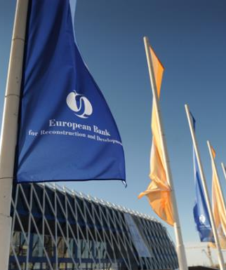
Contacts
For all further enquiries, please contact:
Libor Krkoska Head of Office EBRD in Bosnia and Herzegovina Tel: +387 33 667 945/6/7 Fax: +387 33 667 950 Email: krkoskal@ebrd.com
EBRD, One Exchange Square London, EC2A 2JN United Kingdom www.ebrd.com

